Slide 1

SMS technology pilot – ZPCT II
mHealth Meeting – 20 Apr, 2011
Dr Andrew Kumwenda, Senior Advisor: CT/PMTCT, FHI/ZPCT II

Slide 2
Background (1)
ZPCT II - FHI contract with USAID through PEPFAR (June 2009 – May 2014) supports the MOH to strengthen and expand HIV/AIDS services in five of Zambia’s nine provinces: Central, Copperbelt, Luapula, Northern and North Western
ZPCT II is one of the partners piloting the use of SMS technology in 23 of its supported health facilities in Zambia

Slide 3
Background (2):
SMS technology innovation is meant to address challenges observed in HIV care including:
  Delay in parents/guardians getting the PCR results once received at the health facility from the PCR laboratory
  Some clients coming late or never coming at all for their scheduled appointments for other HIV care services.

Slide 4
Objective for the SMS technology pilot
  To strengthen enrolment and improve patient retention in both paediatric and adult HIV care by calling back clients for results and missed appointments.

Slide 5
Categories of clients being sent SMSs:
Uncollected PCR results (whether reactive or not),
Missed ART pharmacy and clinical appointments,
Laboratory results (abnormal/uncollected important results)
Note: A list of clients due to be sent SMSs is supposed to be signed off by the facility in-charge.

Slide 6
Early Infant Diagnosis (EID) in ZPCT II
ZPCT set up a PCR lab in 2007 at Arthur Davison Children’s Hospital (ADCH) in Ndola, Copperbelt province to improve access to EID in five northern provinces through Dried Blood Spot (DBS)
  Laboratory officially opened on 2nd August 2007
  Began operations in September 2007
Specimens collected as DBS at healthcare facilities and transported to laboratory by Express Mail Service (EMS)

Slide 7
Process of testing infants in Zambia
PCR testing at 6/52 & 6/12 for HIV exposed infants recommended
Dried Blood Spot (DBS) samples collected at facilities
Samples go: Clinic → Hub → DNA PCR Lab (tested)
Test results go: Lab→ Hub → Clinic
  Clinic can then try to contact the caregiver for follow up
  Sometimes caregiver lost due to several factors
Only 3 labs in Zambia offer DNA PCR testing
Clinic
District Hub
Lab

Slide 8
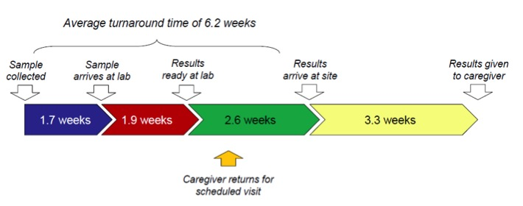
Current EID Situation in Zambia
From sample collection to results received at facility ➔ 6.2 weeks
SMS delivery of results should eliminate the 2.6 and 3.3. weeks
MOH Baseline EID assessment, 2008
Notes:
Chai from 2008

Slide 9
How clients to be recalled are identified:
Through:
  Routine clinic visits for HIV exposed infants in the under-five clinic (i.e. at the time of DBS sample collection)
  Using facility registers and SmartCare clinical reports on a weekly basis in the ART clinics.
  All clients or parents/guardians (for DBS results) need to sign a consent form allowing the health facility to send them an SMS as a reminder if need arises.

Slide 10
Expected outcomes
Improved pick up of PCR results,
Increased uptake in paediatric ART services and retention of clients in various HIV prevention, care and treatment programs.
As the ultimate, improvement in quality of care for the clients.

Slide 11
Facility operations
An SOP – guide has been developed
SOP Highlights include:
  All reminder client lists are generated by respective depts (CC, lab/pharmacy, MNCH)
  Data entry clerk consolidates list and verifies against signed consent forms
  Consolidated list is signed off by health facility in-charge

Slide 12
Other SMS pilots in Zambia:
Luapula and Southern Province (UNICEF)
  Facility and providers personal phones registered with system
  Messages automatically sent
  Results messages require password to view
  Results only use EID numbers, no name
Central, Northern, Copperbelt Provinces (CHAI)
  SMS printers registered in the ADCH data base
  Messages automatically sent and printed by the printers located at the clinics

Slide 13
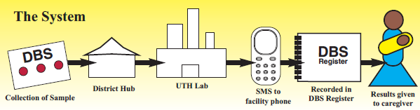
Southern & Luapula Province SMS
10 facilities in Southern Province and 11 facilities in Luapula Province with SMS phones
  Urban, Peri-Urban, Rural
  DBS samples tested at UTH & ADH
  Data transferred to MoH from MS Access database at labs
  Results sent MoH to facilities
Phones automatically notified of ready results
  Facilities can check if any are ready at any time
  Facilities can check specific results at any time
Notes:
Ministry of health EID assesment CHAI 2008

Slide 14
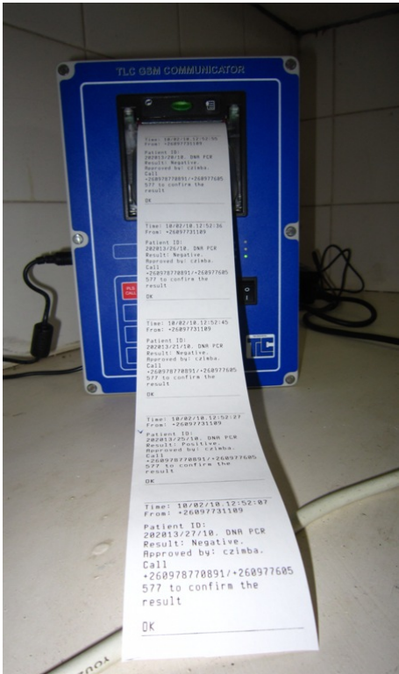
CHAI Update
5 facilities in NP, CP & CB
Urban, Peri-Urban, Rural
DBS samples tested at ADCH
  Data transferred to MoH
  Results sent back to facilities through SMS to a printer
  Hard copy results follow later
Helpline has been established
MS Access Database used to enter test data at ADCH

Slide 15
Printer Pilot Turn Around Time
Copperbelt Province
  Without SMS - 2 weeks
  With SMS - 4-5 days
Central Province
  Without SMS - 2 -3 weeks
  With SMS - 4- 5 days
Northern Province
  Without SMS – 2-4 weeks
  With SMS – 5 days
CHAI pilot

Slide 16
Challenges with EID:
Significant delay in sample transport from facilities to hubs and subsequently to the courier for express mail service (EMS)
Stock outs for DBS bundles at the clinics and national level
Reaching care givers to come in for results
  Not all have phones
  Network coverage is not consistent
  Phones are not personal at times

Slide 17
Thank you

